Slide 1
DEEP LEARNING

Slide 2
What is Deep Learning?
Deep learning is a subset of machine learning which provides the ability to machine to perform human-like tasks without human involvement. It provides the ability to an AI agent to mimic the human brain. Deep learning can use both supervised and unsupervised learning to train an AI agent.
  Deep learning is implemented through neural networks architecture hence also called a deep neural network.
  Deep learning is the primary technology behind self-driving cars, speech recognition, image recognition, automatic machine translation, etc.
  The main challenge for deep learning is that it requires lots of data with lots of computational power.

Slide 3
Deep learning refers to a class of machine learning techniques that employ numerous layers to extract higher-level features from raw data.
Lower layers in image processing, for example, may recognize edges, whereas higher layers may identify human-relevant notions like numerals, letters, or faces.
Deep learning uses artificial neural networks, which are supposed to mimic how humans think and learn, as opposed to machine learning, which uses simpler principles.
Up until recently, the complexity of neural networks was constrained by processing capacity. Larger, more powerful neural networks are now possible thanks to advances in Big Data analytics, allowing computers to monitor, learn, and react to complicated events faster than people.
Image categorization, language translation, and speech recognition have all benefited from deep learning.
It can tackle any pattern recognition problem without the need for human intervention.

Slide 4
Deep learning models are capable enough to focus on the accurate features themselves by requiring a little guidance from the programmer and are very helpful in solving out the problem of dimensionality. Deep learning algorithms are used, especially when we have a huge no of inputs and outputs.
Since deep learning has been evolved by the machine learning, which itself is a subset of artificial intelligence and as the idea behind the artificial intelligence is to mimic the human behavior, so same is "the idea of deep learning to build such algorithm that can mimic the brain".
Deep learning is implemented with the help of Neural Networks, and the idea behind the motivation of Neural Network is the biological neurons, which is nothing but a brain cell.
So basically, deep learning is implemented by the help of deep networks, which are nothing but neural networks with multiple hidden layers.
Deep learning is a collection of statistical techniques of machine learning for learning feature hierarchies that are actually based on artificial neural networks.

Slide 5
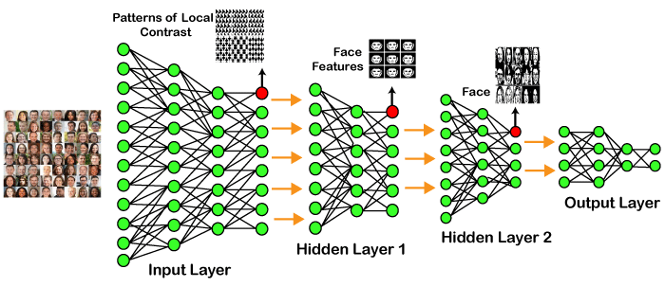
Example of Deep Learning:

Slide 6
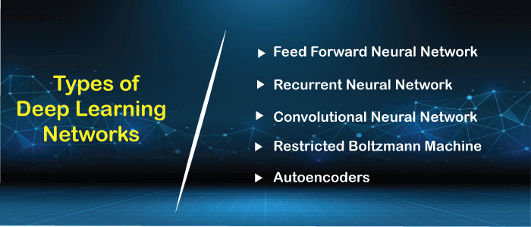
Types of Deep Learning Networks:

Slide 7
1. Feed Forward Neural Network:
A feed-forward neural network is none other than an Artificial Neural Network, which ensures that the nodes do not form a cycle. In this kind of neural network, all the perceptrons are organized within layers, such that the input layer takes the input, and the output layer generates the output. Since the hidden layers do not link with the outside world, it is named as hidden layers.
Each of the perceptrons contained in one single layer is associated with each node in the subsequent layer. It can be concluded that all of the nodes are fully connected. It does not contain any visible or invisible connection between the nodes in the same layer. There are no back-loops in the feed-forward network. To minimize the prediction error, the backpropagation algorithm can be used to update the weight values.
Applications:
  Data Compression
  Pattern Recognition
  Computer Vision
  Sonar Target Recognition
  Speech Recognition
  Handwritten Characters Recognition

Slide 8
2. Recurrent Neural Network:
Recurrent neural networks are yet another variation of feed-forward networks. Here each of the neurons present in the hidden layers receives an input with a specific delay in time. The Recurrent neural network mainly accesses the preceding info of existing iterations. For example, to guess the succeeding word in any sentence, one must have knowledge about the words that were previously used.
It not only processes the inputs but also shares the length as well as weights crossways time. It does not let the size of the model to increase with the increase in the input size. However, the only problem with this recurrent neural network is that it has slow computational speed as well as it does not contemplate any future input for the current state. It has a problem with reminiscing prior information.
Applications:
  Machine Translation
  Robot Control
  Time Series Prediction
  Speech Recognition
  Speech Synthesis
  Time Series Anomaly Detection
  Rhythm Learning
  Music Composition

Slide 9
3. Convolutional Neural Network:
Convolutional Neural Networks are a special kind of neural network mainly used for image classification, clustering of images and object recognition.
DNNs enable unsupervised construction of hierarchical image representations.
To achieve the best accuracy, deep convolutional neural networks are preferred more than any other neural network.
Applications:
  Identify Faces, Street Signs, Tumors.
  Image Recognition.
  Video Analysis.
  NLP.
  Anomaly Detection.
  Drug Discovery.
  Checkers Game.
  Time Series Forecasting.

Slide 10
4. Restricted Boltzmann Machine:
RBMs are yet another variant of Boltzmann Machines. Here the neurons present in the input layer and the hidden layer encompasses symmetric connections amid them. However, there is no internal association within the respective layer.
But in contrast to RBM, Boltzmann machines do encompass internal connections inside the hidden layer.
These restrictions in BMs helps the model to train efficiently.
Applications:
  Filtering.
  Feature Learning.
  Classification.
  Risk Detection.
  Business and Economic analysis.

Slide 11
5. Autoencoders:
An autoencoder neural network is another kind of unsupervised machine learning algorithm. Here the number of hidden cells is merely small than that of the input cells. But the number of input cells is equivalent to the number of output cells.
An autoencoder network is trained to display the output similar to the fed input to force AEs to find common patterns and generalize the data.
The autoencoders are mainly used for the smaller representation of the input.
It helps in the reconstruction of the original data from compressed data. This algorithm is comparatively simple as it only necessitates the output identical to the input.
Encoder: Convert input data in lower dimensions.
Decoder: Reconstruct the compressed data.
Applications:
  Classification.
  Clustering.
  Feature Compression.

Slide 12
Deep learning applications:
Self-Driving Cars
In self-driven cars, it is able to capture the images around it by processing a huge amount of data, and then it will decide which actions should be incorporated to take a left or right or should it stop. So, accordingly, it will decide what actions it should take, which will further reduce the accidents that happen every year.
Voice Controlled Assistance
When we talk about voice control assistance, then Siri is the one thing that comes into our mind. So, you can tell Siri whatever you want it to do it for you, and it will search it for you and display it for you.
Automatic Image Caption Generation
Whatever image that you upload, the algorithm will work in such a way that it will generate caption accordingly. If you say blue colored eye, it will display a blue-colored eye with a caption at the bottom of the image.
Automatic Machine Translation
With the help of automatic machine translation, we are able to convert one language into another with the help of deep learning.

Slide 13
Advantages:
It lessens the need for feature engineering.
It eradicates all those costs that are needless.
It easily identifies difficult defects.
It results in the best-in-class performance on problems.
Limitations:
It only learns through the observations.
It comprises of biases issues.
Disadvantages:
It requires an ample amount of data.
It is quite expensive to train.
It does not have strong theoretical groundwork.

Slide 14
Deep Learning Algorithms

Slide 15
What is Deep Learning Algorithm?
Deep learning can be defined as the method of machine learning and artificial intelligence that is intended to intimidate humans and their actions based on certain human brain functions to make effective decisions.
It is a very important data science element that channels its modeling based on data-driven techniques under predictive modeling and statistics.
To drive such a human-like ability to adapt and learn and to function accordingly, there have to be some strong forces which we popularly called algorithms.
Deep learning algorithms are dynamically made to run through several layers of neural networks, which are nothing but a set of decision-making networks that are pre-trained to serve a task.
Later, each of these is passed through simple layered representations and move on to the next layer. However, most machine learning is trained to work fairly well on datasets that have to deal with hundreds of features or columns.
For a data set to be structured or unstructured, machine learning tends to fail mostly because they fail to recognize a simple image having a dimension of 800x1000 in RGB.
It becomes quite unfeasible for a traditional machine learning algorithm to handle such depths. This is where deep learning

Slide 16
Importance of Deep Learning:
Deep learning algorithms play a crucial role in determining the features and can handle the large number of processes for the data that might be structured or unstructured.
Although, deep learning algorithms can overkill some tasks that might involve complex problems because they need access to huge amounts of data so that they can function effectively.
For example, there's a popular deep learning tool that recognizes images namely Imagenet that has access to 14 million images in its dataset-driven algorithms.
It is a highly comprehensive tool that has defined a next-level benchmark for deep learning tools that aim images as their dataset.
Deep learning algorithms are highly progressive algorithms that learn about the image that we discussed previously by passing it through each neural network layer.
The layers are highly sensitive to detect low-level features of the image like edges and pixels and henceforth the combined layers take this information and form holistic representations by comparing it with previous data.
For example, the middle layer might be programmed to detect some special parts of the object in the photograph which other deep trained layers are programmed to detect special objects like dogs, trees, utensils, etc.

Slide 17
However, if we talk out the simple task that involves less complexity and a data-driven resource, deep learning algorithms fail to generalize simple data.
This is one of the main reasons deep learning is not considered effective as linear or boosted tree models.
Simple models aim to churn out custom data, track fraudulent transactions and deal with less complex datasets with fewer features.
Also, there are various cases like multiclass classification where deep learning can be effective because it involves smaller but more structured datasets but is not preferred usually.
Having said that, let's look understand some of the most important deep learning algorithms given below.

Slide 18
Deep Learning Algorithms:
The Deep Learning Algorithms are as follows:
1. Convolutional Neural Networks (CNNs):
CNN's popularly known as ConvNets majorly consists of several layers and are specifically used for image processing and detection of objects. It was developed in 1998 by Yann LeCun and was first called LeNet. Back then, it was developed to recognize digits and zip code characters. CNNs have wide usage in identifying the image of the satellites, medical image processing, series forecasting, and anomaly detection.
CNNs process the data by passing it through multiple layers and extracting features to exhibit convolutional operations. The Convolutional Layer consists of Rectified Linear Unit (ReLU) that outlasts to rectify the feature map. The Pooling layer is used to rectify these feature maps into the next feed.
Pooling is generally a sampling algorithm that is down-sampled and it reduces the dimensions of the feature map. Later, the result generated consists of 2-D arrays consisting of single, long, continuous, and linear vector flattened in the map. The next layer i.e., called Fully Connected Layer which forms the flattened matrix or 2-D array fetched from the Pooling Layer as input and identifies the image by classifying it.

Slide 19
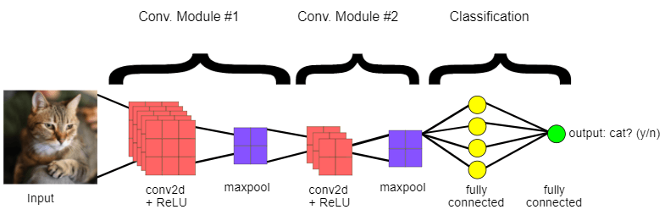

Slide 20
2. Long Short Term Memory Networks (LSTMs):
LSTMs can be defined as Recurrent Neural Networks (RNN) that are programmed to learn and adapt for dependencies for the long term.
It can memorize and recall past data for a greater period and by default, it is its sole behavior. LSTMs are designed to retain over time and henceforth they are majorly used in time series predictions because they can restrain memory or previous inputs. This analogy comes from their chain-like structure consisting of four interacting layers that communicate with each other differently. Besides applications of time series prediction, they can be used to construct speech recognizers, development in pharmaceuticals, and composition of music loops as well.
LSTM work in a sequence of events. First, they don't tend to remember irrelevant details attained in the previous state. Next, they update certain cell-state values selectively and finally generate certain parts of the cell-state as output. Below is the diagram of their operation.

Slide 21
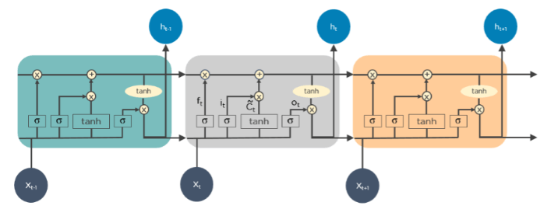

Slide 22
3. Recurrent Neural Networks (RNNs):
Recurrent Neural Networks or RNNs consist of some directed connections that form a cycle that allow the input provided from the LSTMs to be used as input in the current phase of RNNs.
These inputs are deeply embedded as inputs and enforce the memorization ability of LSTMs lets these inputs get absorbed for a period in the internal memory.
RNNs are therefore dependent on the inputs that are preserved by LSTMs and work under the synchronization phenomenon of LSTMs.
RNNs are mostly used in captioning the image, time series analysis, recognizing handwritten data, and translating data to machines. RNNs follow the work approach by putting output feeds (t-1) time if the time is defined as t. Next, the output determined by t is feed at input time t+1. Similarly, these processes are repeated for all the input consisting of any length. There's also a fact about RNNs is that they store historical information and there's no increase in the input size even if the model size is increased. RNNs look something like this when unfolded.

Slide 23
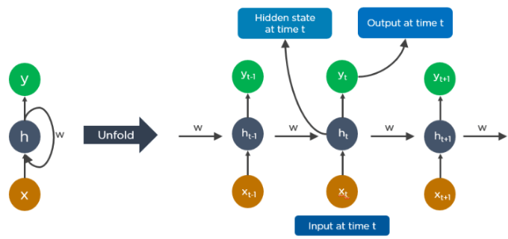

Slide 24
4. Generative Adversarial Networks (GANs):
GANs are defined as deep learning algorithms that are used to generate new instances of data that match the training data. GAN usually consists of two components namely a generator that learns to generate false data and a discriminator that adapts itself by learning from this false data.
Over some time, GANs have gained immense usage since they are frequently being used to clarify astronomical images and simulate lensing the gravitational dark matter. It is also used in video games to increase graphics for 2D textures by recreating them in higher resolution like 4K. They are also used in creating realistic cartoons character and also rendering human faces and 3D object rendering.
GANs work in simulation by generating and understanding the fake data and the real data. During the training to understand these data, the generator produces different kinds of fake data where the discriminator quickly learns to adapt and respond to it as false data. GANs then send these recognized results for updating. Consider the below image to visualize the functioning.

Slide 25
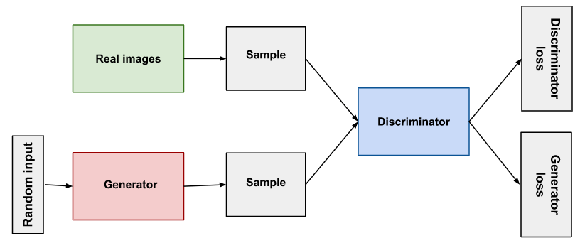

Slide 26
5. Radial Basis Function Networks (RBFNs):
RBFNs are specific types of neural networks that follow a feed-forward approach and make use of radial functions as activation functions. They consist of three layers namely the input layer, hidden layer, and output layer which are mostly used for time-series prediction, regression testing, and classification.
RBFNs do these tasks by measuring the similarities present in the training data set.
They usually have an input vector that feeds these data into the input layer thereby confirming the identification and rolling out results by comparing previous data sets.
Precisely, the input layer has neurons that are sensitive to these data and the nodes in the layer are efficient in classifying the class of data.
Neurons are originally present in the hidden layer though they work in close integration with the input layer. The hidden layer contains Gaussian transfer functions that are inversely proportional to the distance of the output from the neuron's center.
The output layer has linear combinations of the radial-based data where the Gaussian functions are passed in the neuron as parameter and output is generated. Consiider the given image below to understand the process thoroughly.

Slide 27
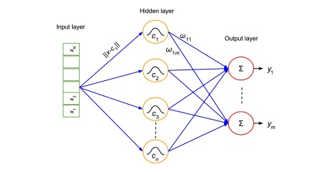

Slide 28
6. Multilayer Perceptrons (MLPs):
MLPs are the base of deep learning technology. It belongs to a class of feed-forward neural networks having various layers of perceptrons.
These perceptrons have various activation functions in them. MLPs also have connected input and output layers and their number is the same. Also, there's a layer that remains hidden amidst these two layers. MLPs are mostly used to build image and speech recognition systems or some other types of the translation software.
The working of MLPs starts by feeding the data in the input layer.
The neurons present in the layer form a graph to establish a connection that passes in one direction. The weight of this input data is found to exist between the hidden layer and the input layer. MLPs use activation functions to determine which nodes are ready to fire. These activation functions include tanh function, sigmoid and ReLUs. MLPs are mainly used to train the models to understand what kind of co-relation the layers are serving to achieve the desired output from the given data set. See the below image to understand better.

Slide 29
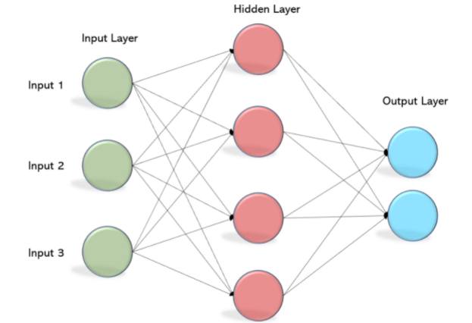

Slide 30
7. Autoencoders:
Autoencoders are a special type of neural network where inputs are outputs are found usually identical. It was designed to primarily solve the problems related to unsupervised learning. Autoencoders are highly trained neural networks that replicate the data. It is the reason why the input and output are generally the same. They are used to achieve tasks like pharma discovery, image processing, and population prediction.
Autoencoders constitute three components namely the encoder, the code, and the decoder. Autoencoders are built in such a structure that they can receive inputs and transform them into various representations. The attempts to copy the original input by reconstructing them is more accurate. They do this by encoding the image or input, reduce the size. If the image is not visible properly they are passed to the neural network for clarification. Then, the clarified image is termed a reconstructed image and this resembles as accurate as of the previous image. To understand this complex process, see the below-provided image.

Slide 31
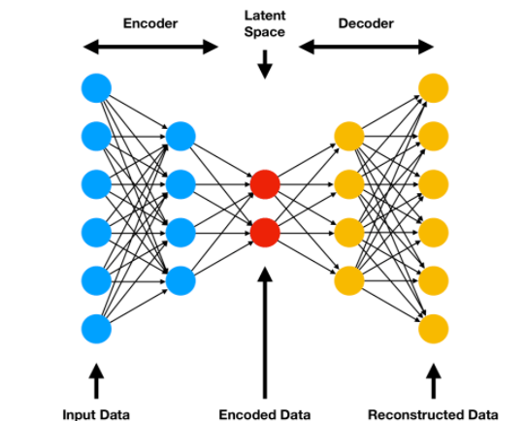

Slide 32
CASE STUDY:
IPL SCORE PREDICTION USING DEEP LEARNING:
PROBLEM STATEMENT:
Since the dawn of the IPL in 2008, it has attracted viewers all around the globe.
A high level of uncertainty and last moment nail biters has urged fans to watch the matches. Within a short period, IPL has become the highest revenue-generating league of cricket.
In a cricket match, we often see the scoreline showing the probability of the team winning based on the current match situation.
This prediction is usually done with the help of Data Analytics. Before when there were no advancements in machine learning, the prediction was usually based on intuitions or some basic algorithms.
The above picture clearly tells you how bad is taking run rate as a single factor to predict the final score in a limited-overs cricket match.

Slide 33
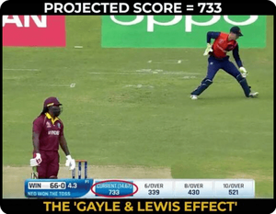
visualizing the statistics of cricket is mesmerizing. We went through various blogs and found out patterns that could be used for predicting the score of IPL matches beforehand.

Slide 34
Why Deep Learning?
We humans can’t easily identify patterns from huge data and thus here, machine learning and deep learning comes into play. It learns how the players and teams have performed against the opposite team previously and trains the model accordingly. Using only machine learning algorithm gives a moderate accuracy therefore we used deep learning which gives much better performance than our previous model and considers the attributes which can give accurate results.
Tools used:
  Jupyter Notebook / Google colab
  Visual Studio
Technology used:
  Machine Learning.
  Deep Learning
  Flask (Front-end integration).
  Well, for the smooth running of the project we’ve used few libraries like NumPy, Pandas, Scikit-learn, TensorFlow, and Matplotlib.

Slide 35
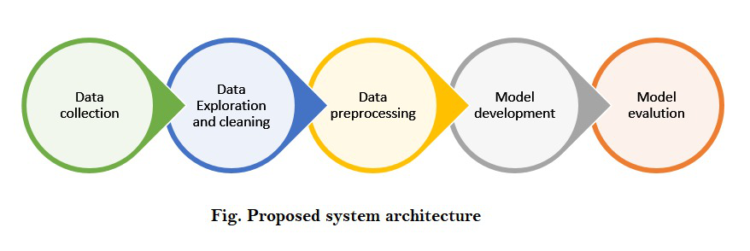
The architecture of model:

Slide 36
Step-by-step implementation:
First, let’s import all the necessary libraries:
  import pandas as pd
  import numpy as np
  import matplotlib.pyplot as plt
  import seaborn as sns
  from sklearn import preprocessing
Step 1: Understanding the dataset
When dealing with cricket data, Cricsheet is considered as an appropriate platform for gathering the data and thus we took the data from https://cricsheet.org/downloads/ipl.zip. It contains data from the year 2007 to 2021. For better accuracy of our model, we used IPL players’ stats to analyze their performance from here. This dataset contains details of every IPL player from the year 2016 – 2019.

Slide 37
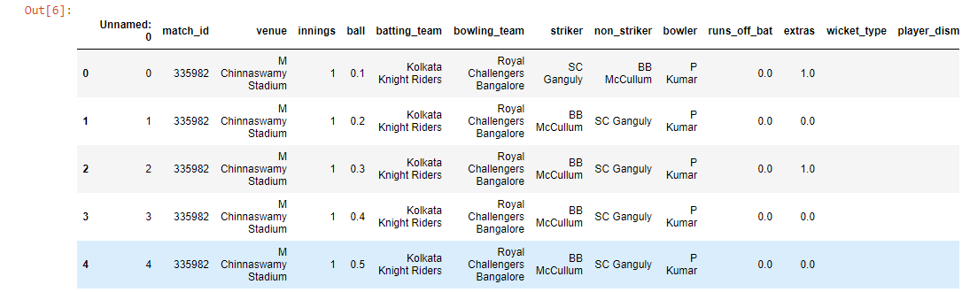
Step 2: Data cleaning and formatting
We imported both the datasets using .read_csv() method into a dataframe using pandas and displayed the first 5 rows of each dataset. We did some changes to our dataset like added a new column named “y” which had the runs scored in the first 6 overs from that particular inning.
  ipl = pd.read_csv('ipl_dataset.csv')
  ipl.head()

Slide 38
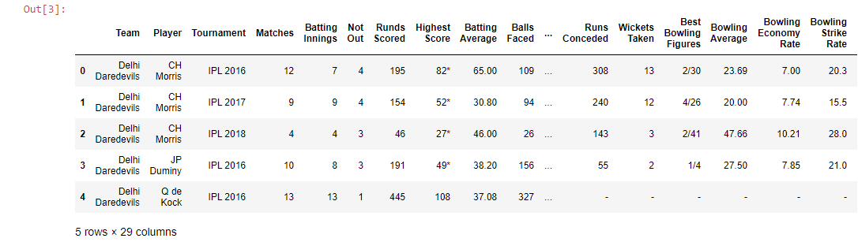
data = pd.read_csv('IPL Player Stats - 2016 till 2019.csv')
data.head()
Now, we will merge both datasets.
ipl= ipl.drop(['Unnamed: 0','extras','match_id', 'runs_off_bat'],axis = 1)
new_ipl = pd.merge(ipl,data,left_on='striker',right_on='Player',how='left')
new_ipl.drop(['wicket_type', 'player_dismissed'],axis=1,inplace=True)
new_ipl.columns

Slide 39
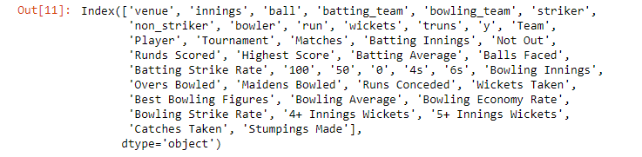
After merging the columns and removing new unwanted columns, we have the following columns left.
There are various ways to fill null values in our dataset. Here I am simply replacing the categorical values which are nan with ‘.’
str_cols = new_ipl.columns[new_ipl.dtypes==object]
new_ipl[str_cols] = new_ipl[str_cols].fillna('.')

Slide 40
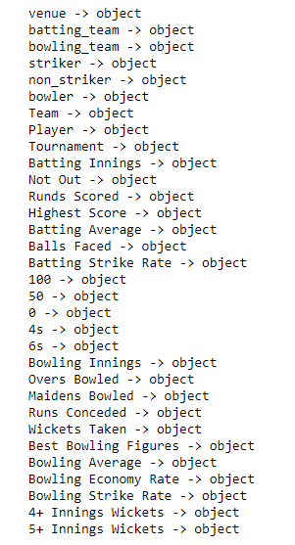
Step 3: Encoding the categorical data to numerical values.
For the columns to be able to assist the model in the prediction, the values should make some sense to the computers. Since they (still) don’t have the ability to understand and draw inferences from the text, we need to encode the strings to numeric categorical values. While we may choose to do the process manually, the Scikit-learn library gives us an option to use LabelEncoder.
listf = []
for c in new_ipl.columns:
if new_ipl.dtype==object:
print(c,"->" ,new_ipl.dtype)
listf.append(c)

Slide 41
a1 = new_ipl['venue'].unique()
a2 = new_ipl['batting_team'].unique()
a3 = new_ipl['bowling_team'].unique()
a4 = new_ipl['striker'].unique()
a5 = new_ipl['bowler'].unique()
def labelEncoding(data):
dataset = pd.DataFrame(new_ipl)
feature_dict ={}
for feature in dataset:
if dataset[feature].dtype==object:
le = preprocessing.LabelEncoder()
fs = dataset[feature].unique()
le.fit(fs)
dataset[feature] = le.transform(dataset[feature])
feature_dict[feature] = le
return dataset
labelEncoding(new_ipl)

Slide 42
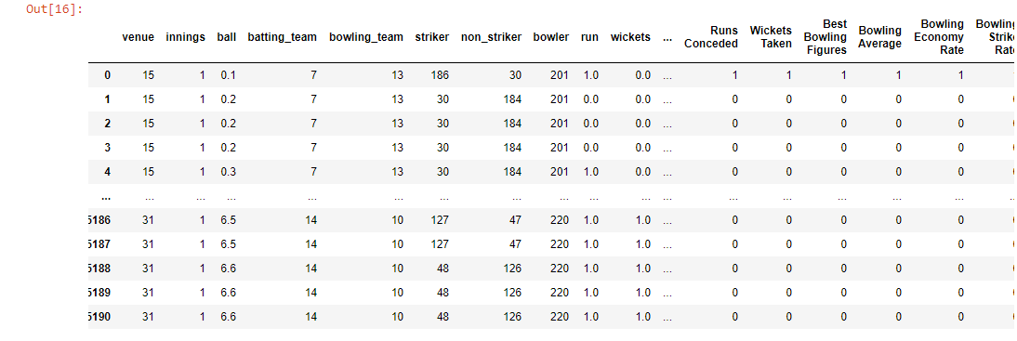

Slide 43
ip_dataset = new_ipl[['venue','innings', 'batting_team', 'bowling_team', 'striker', 'non_striker', 'bowler']]
b1 = ip_dataset['venue'].unique()
b2 = ip_dataset['batting_team'].unique()
b3 = ip_dataset['bowling_team'].unique()
b4 = ip_dataset['striker'].unique()
b5 = ip_dataset['bowler'].unique()
new_ipl.fillna(0,inplace=True)
features={}
for i in range(len(a1)):
features[a1[i]]=b1[i]
for i in range(len(a2)):
features[a2[i]]=b2[i]
for i in range(len(a3)):
features[a3[i]]=b3[i]
for i in range(len(a4)):
features[a4[i]]=b4[i]
for i in range(len(a5)):
features[a5[i]]=b5[i]
features

Slide 44
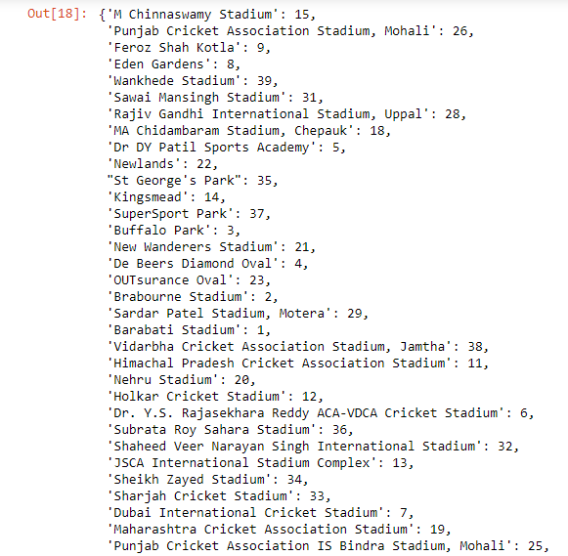

Slide 45
Step 4: Feature Engineering and Selection
Our dataset contains multiple columns, but we can’t take these many inputs from users thus we have taken the selected amount of features as input and divided them into X and y. We will then divide our data into train sets and test set before using a machine learning algorithm.
X = new_ipl[['venue', 'innings','batting_team',
'bowling_team', 'striker','bowler']].values
y = new_ipl['y'].values
from sklearn.model_selection import train_test_split
X_train, X_test, y_train, y_test = train_test_split(
X, y, test_size=0.33, random_state=42)
Comparing these large numerical values by our model will be difficult so it is always a better choice to scale your data before processing it. Here we are using MinMaxScaler from sklearn.preprocessing which is recommended when dealing with deep learning.
from sklearn.preprocessing import MinMaxScaler
scaler = MinMaxScaler()
X_train = scaler.fit_transform(X_train)
X_test = scaler.transform(X_test)
Note: We cannot fit X_test as it is the data which is to be predicted.

Slide 46
Step 5: Building, Training & Testing the Model
Here comes the most exciting part of our project, Building our model! Firstly, we will import Sequential from tensorflow.keras.models Also, we will import Dense & Dropout from tensorflow.keras.layers as we will be using multiple layers.
from tensorflow.keras.models import Sequential
from tensorflow.keras.layers import Dense,Dropout
from tensorflow.keras.callbacks import EarlyStopping
EarlyStopping is used to avoid overfitting.
What early stopping basically does is, it stops calculating the losses when ‘val_loss’ increases than ‘loss’.
Val_loss curve should always be below val curve.
When it is found that the difference between ‘val_loss’ and ‘loss’ is becomes constant, it stops training.

Slide 47
model = Sequential()
model.add(Dense(43, activation='relu'))
model.add(Dropout(0.5))
model.add(Dense(22, activation='relu'))
model.add(Dropout(0.5))
model.add(Dense(11, activation='relu'))
model.add(Dropout(0.5))
model.add(Dense(1))
model.compile(optimizer='adam', loss='mse')

Slide 48
Here, we have created 2 hidden layers and reduced the number of neurons as we want the final output to be 1.
Then while compiling our model we used adam optimizer and loss as mean squared error.
Now, let’s start training our model with epochs=400.
model.fit(x=X_train, y=y_train, epochs=400,
validation_data=(X_test,y_test),
callbacks=[early_stop] )
It will take some time because of a huge number of samples and epochs and will output the ‘loss’ and ‘val_loss’ of each sample as below.

Slide 49
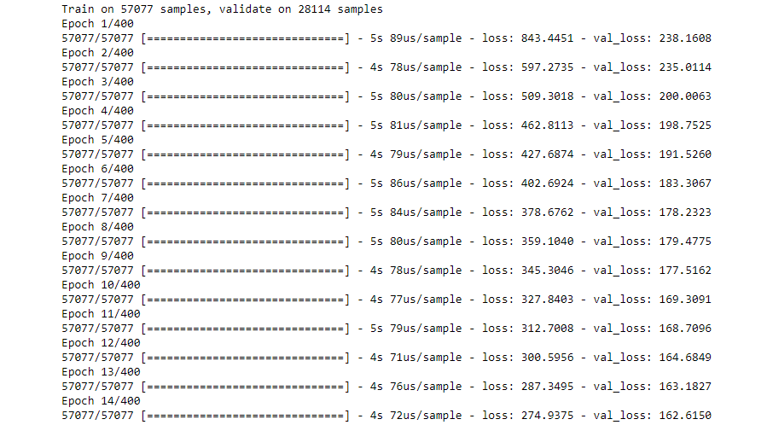

Slide 50
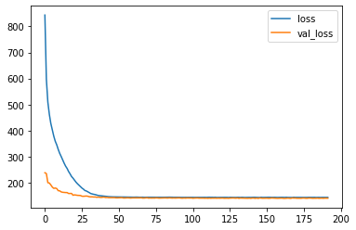
After the training is complete, let us visualize our model’s losses:
model_losses = pd.DataFrame(model.history.history)
model_losses.plot()
As we can see our model is having absolutely perfect behavior!

Slide 51
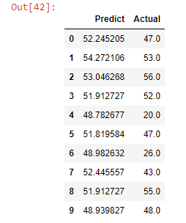
Step 6: Predictions
Here we come to the final part of our project where we will be predicting our X_test. Then we will create a dataframe that would show us the actual values and the predicted values.
  predictions = model.predict(X_test)
  sample = pd.DataFrame(predictions,columns=['Predict'])
  sample['Actual']=y_test
  sample.head(10)

Slide 52

As we can see, our model is predicting quite well. It is giving us almost similar scores.
To find out more accurately the difference between actual and predicted scores, performance metrics will show us the error rate using mean_absolute_error and mean_squared_error from sklearn.metrics
Performance Metrics:
from sklearn.metrics import mean_absolute_error,mean_squared_error
mean_absolute_error(y_test,predictions)

Slide 53

np.sqrt(mean_squared_error(y_test,predictions))

Slide 54
THE END

